Slide 1
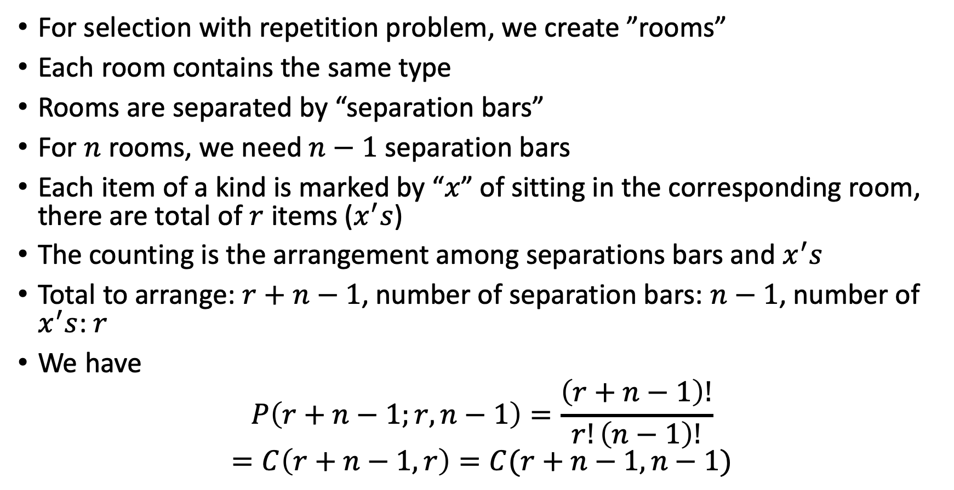
The separation bar method
For selection with repetition problem, we create ”rooms”
Each room contains the same type
Rooms are separated by “separation bars”
For $n$ rooms, we need $n−1$ separation bars
Each item of a kind is marked by “$x$” of sitting in the corresponding room, there are total of $r$ items ($x^{′}s$)
The counting is the arrangement among separations bars and $x^{′}s$
Total to arrange: $r+n−1$, number of separation bars: $n−1$, number of $x^{′}s$: $r$
We have
$$P\left(r+n−1;r, n−1\right)=\frac{\left(r+n−1\right)!}{r!\left(n−1\right)!}$$
$$=C\left(r+n−1,r\right)=C(r+n−1,n−1)$$

Slide 2
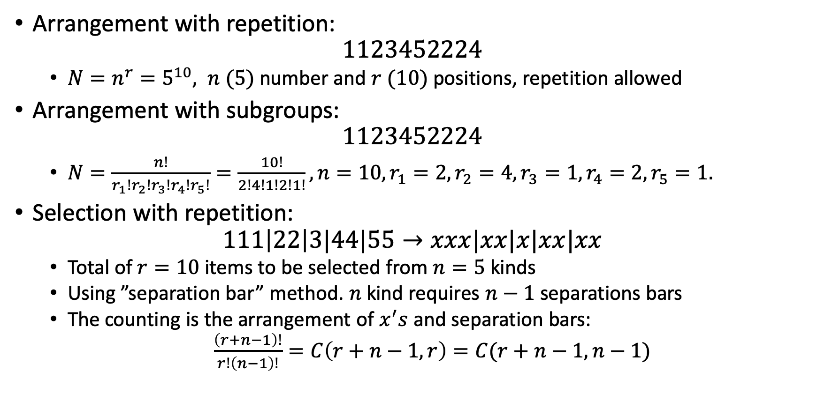
Summary of counting with repetitions
Arrangement with repetition:
$$1123452224$$
$N=n^{r}=5^{10}, n (5)$ number and $r (10)$ positions, repetition allowed
Arrangement with subgroups:
$$1123452224$$
$N=\frac{n!}{r_{1}!r_{2}!r_{3}!r_{4}!r_{5}!}=\frac{10!}{2!4!1!2!1!}, n=10, r_{1}=2, r_{2}=4, r_{3}=1, r_{4}=2, r_{5}=1.$
Selection with repetition:
$$111\left|22\right|3|44|55→xxx|xx|x|xx|xx$$
Total of $r=10$ items to be selected from $n=5$ kinds
Using ”separation bar” method. $n$ kind requires $n−1$ separations bars
The counting is the arrangement of $x^{′}s$ and separation bars:
$\frac{\left(r+n−1\right)!}{r!\left(n−1\right)!}=C\left(r+n−1,r\right)=C(r+n−1,n−1)$

Slide 3
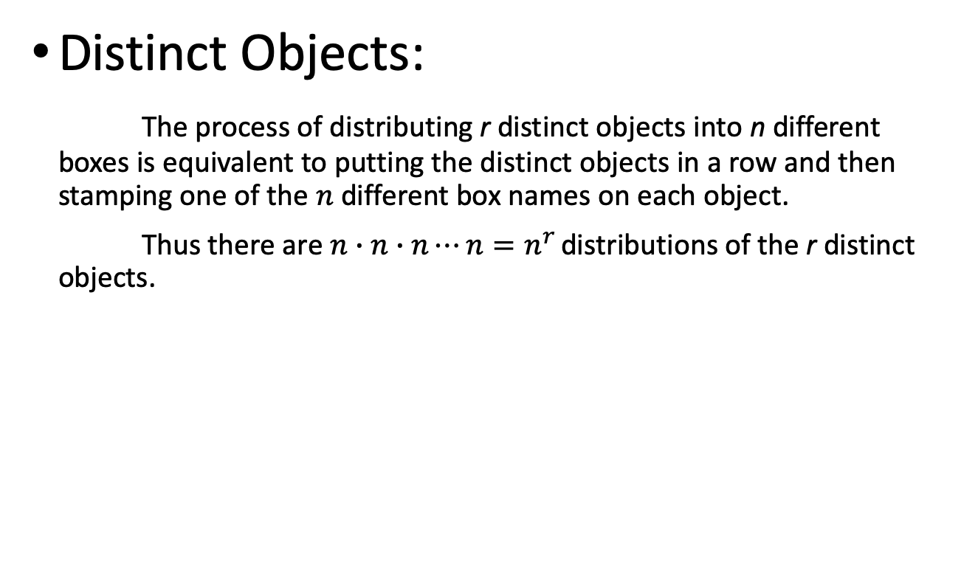
Basic Models for Distributions
Distinct Objects:
The process of distributing r distinct objects into n different boxes is equivalent to putting the distinct objects in a row and then stamping one of the $n$ different box names on each object.
Thus there are $n∙n∙n⋯n=n^{r}$ distributions of the r distinct objects.
r distinct objects
n different boxes
Red Red Blue Green

Slide 4
Specified amount in each box
If r_{i} objects must go in box i, then there are P(r; r₁, r₂, …, r_{n}) distributions.
6 distinct objects
How many in each box
3
1
2

Slide 5
Basic Models for Distributions
Identical Objects:
The process of distributing r identical objects into n different boxes is equivalent to choosing an (unordered) subset of r box names with repetition from among the n choices of boxes.
Thus there are C(r+n-1, r) = (r+n-1)!/r!(n-1)! distributions of the r identical objects.
r identical objects
Red Red Blue Blue Green Green Green

Slide 6
Equivalent Forms for Selection with Repetition
The number of ways to select r objects with repetition from n different types of objects.
The number of ways to distribute r identical objects into n distinct boxes.
The number of nonnegative integer solutions to x₁+x₂+…+x_{n}=r.
7 identical objects into 3 distinct boxes
Red Red Blue Blue Green Green Green
7 = 2 + 2 + 3

Slide 7
Ways to Arrange, Select, or Distribute r Objects from n Items or into n Boxes
Combination (unordered outcome)
or
Distribution of identical objects
Arrangement (ordered outcome)
or
Distribution of distinct objects
No repetition P(n,r) C(n,r)
Unlimited Repetition n ^{r} C(r+n-1, r)
Restricted Repetition P(r; r₁, r₂, …, r_{n}) --------

Slide 8
Example 1
How many ways are there to assign 100 different diplomats to 5 different continents? How many ways if 20 diplomats must be assigned to each continent?
For part one we want to use the distinct objects with unlimited repetition model from below.
For the second part we want to use the distinct objects with restricted repetition model from below.
Distribution of distinct objects
Distribution of identical objects
No repetition P(n,r) C(n,r)
Unlimited Repetition n ^{r} C(r+n-1, r)
Restricted Repetition P(r; r₁, r₂, …, r_{n}) -----

Slide 9
Example 1 (Continued)
These are distinct objects according to the model for distributions. Following that model that means it equals the number of sequences of length 100 involving 5 continents.
5¹⁰⁰ sequences.
If you add the constraint of assigning 20 diplomats to each continent, that means that each continent name should appear 20 times in a sequence.
P(100; 20, 20, 20, 20, 20) = 100!/(20!)⁵ ways.

Slide 10
Example 2
In Bridge, the 52 cards of a standard card deck are randomly dealt 13 apiece to players North, East, South, and West. What is the probability that West has all 13 spades? That each player has one Ace?
First, how many ways (without any restriction) to distribute 52 cards to four people, each has 13 cards?
Distribution of distinct objects
Distribution of identical objects
No repetition P(n,r) C(n,r)
Unlimited Repetition n ^{r} C(r+n-1, r)
Restricted Repetition P(r; r₁, r₂, …, r_{n}) -----

Slide 11
Example 2 (part 1)
Count the ways West can get all spades-- 1 way.
Count the ways to distribute the 39 non-spade cards among the 3 other hands-- P(39; 13, 13, 13) ways.
To get the probability, divide by the distributions of the 52 cards into 13-card hands-- P(52; 13, 13, 13, 13) ways.
39!
52!
52!
52
= 1
( )
= 1
13
(13!)³
(13!)⁴
13!39!
Alternatively, ask the probability that West has all 13 spades (one way) out of all ways West can be dealt 13 cards:
1/C(52,13).

Slide 12
Example 2 (part 2)
What is the probability that each player has one Ace?
First distribute the Aces– 4! Ways.
Then distribute the 48 non-Aces—
P(48; 12, 12, 12, 12) = 48! / (12!)⁴ ways.
So the probability that each player gets an Ace is:

Slide 13
Example 3
Show that the number of ways to distribute r identical balls into n distinct boxes with at least one ball in each box is C(r-1, n-1). With at least r₁ balls in the first box, at least r₂ balls in the second box, …, and at least r_{n} balls in the n^{th} box, the number is C(r - r₁ - r₂ -…- r_{n} + n – 1, n-1).
This is called “minimum condition” problem, the rule is: “satisfy it first”. The key word is: ”at least”.
Distribution of distinct objects
Distribution of identical objects
No repetition P(n,r) C(n,r)
Unlimited Repetition n ^{r} C(r+n-1, r)
Restricted Repetition P(r; r₁, r₂, …, r_{n}) -----

Slide 14
Example 3 (at least one ball in each box)
First put one ball in each of the r boxes.
Then count the ways to distribute without restriction the remaining r-n balls into the n boxes. You can do this in
[(r-n)+n-1]!
(r-n)!(n-1)!
C((r-n)+n-1, (r-n)) =
= C(r-1, n-1) ways.
Recalling that the number of ways to distribute R things
without restriction into N boxes is C(R+N-1, R).
back

Slide 15
Example 3 (r_{i} balls in the i^{th} box)
First, for each i11/16/2025, put r_{i} balls in the i^{th} box.
Note that there are now r-r₁-r₂-…-r_{n} balls left.
Finally, count the ways to distribute without restriction the remaining r-r₁-r₂-…-r_{n} balls into the n boxes.
This can be done in
C((r-r₁-r₂-…-r_{n})+n-1, (r-r₁-r₂-…-r_{n}))
= C((r-r₁-r₂-…-r_{n}) +n-1, n-1) ways.
Recalling that the number of ways to distribute R things
without restriction into N boxes is C(R+N-1, R).
back

Slide 16
Example 4
How many integer solutions are there to the equation
x₁ + x₂ + x₃ + x₄ = 12, with x_{i} > 0?
How many solutions with x_{i} > 1?
How many solutions with x₁ > 2, x₂ > 2, x₃ > 4, x₄ > 0?
Distribution of distinct objects
Distribution of identical objects
No repetition P(n,r) C(n,r)
Unlimited Repetition n ^{r} C(r+n-1, r)
Restricted Repetition P(r; r₁, r₂, …, r_{n}) -----

Slide 17
Example 4 (Continued)
How many integer solutions are there to the equation x₁ + x₂ + x₃ + x₄ = 12, with x_{i} > 0?
An example of one solution is: x₁ = 2, x₂ = 3, x₃ = 3, x₄ = 4.
Two ways to think about this:
Let x_{i} be the number of (identical) objects in box i, or
Let x_{i} be the number of objects of type i chosen.
Either way, the number of integer solutions is
C(12+4-1, 12) = 455.
12 identical objects
Box 1 Box 2 Box 3 Box 4

Slide 18
Example 4 (continue) “Minimum condition” problem The rule is: “satisfy it first”
Solutions with x_{i} > 1: (x_{i}=z_{i}+1)
First put one object in each box, and then solve
z₁ + z₂ + z₃ + z₄ = 12-4 = 8.
C(12-4 +(4-1), 4-1) = C(8+4-1, 4-1) = 165 ways.
Solution with x₁>2, x₂>2, x₃>4, x₄>0: (x₁=z₁+2, x₂=z₂+2 etc)
First put 2 objects in the first and second boxes, 4 objects in the third box, and then solve
z₁ + z₂ + z₃ + z₄ =12 – (2 + 2+4) = 4.
C (12 –(2+2+4) + (4-1), 4-1) = C(4+4-1, 4-1) = 35 ways.

Slide 19
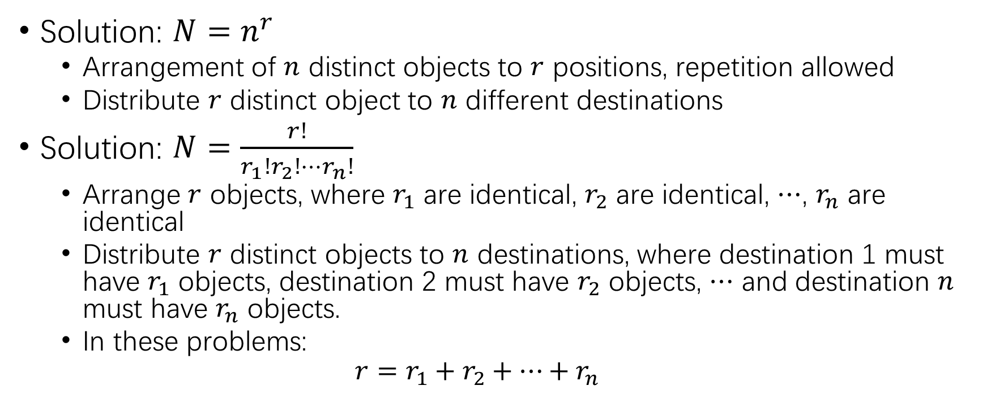
Similarity among arrangement, selection, and integer equation problems
Solution: $N=n^{r}$
Arrangement of $n$ distinct objects to $r$ positions, repetition allowed
Distribute $r$ distinct object to $n$ different destinations
Solution: $N=\frac{r!}{r_{1}!r_{2}!⋯r_{n}!}$
Arrange $r$ objects, where $r_{1}$ are identical, $r_{2}$ are identical, $⋯$, $r_{n}$ are identical
Distribute $r$ distinct objects to $n$ destinations, where destination 1 must have $r_{1}$ objects, destination 2 must have $r_{2}$ objects, $⋯$ and destination $n$ must have $r_{n}$ objects.
In these problems:
$$r=r_{1}+r_{2}+⋯+r_{n}$$

Slide 20
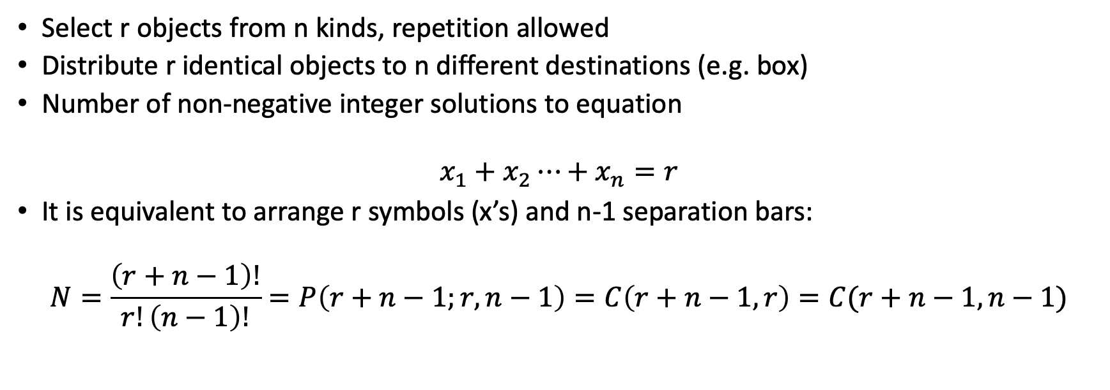
Three problems that can be solved by using the separation bar method
Select r objects from n kinds, repetition allowed
Distribute r identical objects to n different destinations (e.g. box)
Number of non-negative integer solutions to equation
$$x_{1}+x_{2}⋯+x_{n}=r$$
It is equivalent to arrange r symbols (x’s) and n-1 separation bars:
$$N=\frac{\left(r+n−1\right)!}{r!\left(n−1\right)!}=P\left(r+n−1;r,n−1\right)=C\left(r+n−1,r\right)=C(r+n−1,n−1)$$

Slide 21
Class Problem 1
How many ways are there to distribute 20 (identical) sticks of red licorice and 15 (identical) sticks of black licorice among five children?
Hint:
Distribution of distinct objects
Distribution of identical objects
No repetition P(n,r) C(n,r)
Unlimited Repetition n ^{r} C(r+n-1, r)
Restricted Repetition P(r; r₁, r₂, …, r_{n}) -----

Slide 22
Solution
First distribute the red sticks among the 5 children:

Slide 23
Solution
First distribute the red sticks among the 5 children:
There are
C(20+5-1, 20) = 10,626 ways.

Slide 24
Solution
First distribute the red sticks among the 5 children:
There are
C(20+5-1, 20) = 10,626 ways.
Then distribute the 15 identical sticks of black.

Slide 25
Solution
First distribute the red sticks among the 5 children:
There are
C(20+5-1, 20) = 10,626 ways.
Then distribute the 15 identical sticks of black.
There are
C(15+5-1, 15) = 3,876 ways.

Slide 26
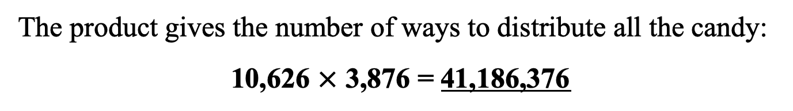
Solution
First distribute the red sticks among the 5 children:
There are
C(20+5-1, 20) = 10,626 ways.
Then distribute the 15 identical sticks of black.
There are
C(15+5-1, 15) = 3,876 ways.
The product gives the number of ways to distribute all the candy:
10,626 $×$ 3,876 = 41,186,376

Slide 27
Class Problem 2
How many binary sequences of length 10 are there consisting of a number of 1s, followed by a number of 0s, followed by a number of 1s, followed by a number of 0s?
E. g. 1110111000.
Hint:
Distribution of distinct objects
Distribution of identical objects
No repetition P(n,r) C(n,r)
Unlimited Repetition n ^{r} C(r+n-1, r)
Restricted Repetition P(r; r₁, r₂, …, r_{n}) -----

Slide 28
Solution
4 Boxes
1’s
0’s
1’s
0’s
1---- 0---- 1----- 0-----
Put one digit in each box.

Slide 29
Solution
4 Boxes
1’s
0’s
1’s
0’s
1---- 0---- 1----- 0-----
Put one digit in each box.
(Corresponds to
1100111000.)
__ __ __ __ __ __

Slide 30
Solution
4 Boxes
1’s
0’s
1’s
0’s
1---- 0---- 1----- 0-----
Put one digit in each box.
(Corresponds to
1100111000.)
__ __ __ __ __ __
Then distribute the remaining 10 – 4 digits into the 4 boxes:
C(6+4-1, 4-1) = C(10-1, 4-1) = 84.
Thus, there are 84 such binary sequences.

Slide 31
Problem 5.4.28
How many ways are there to distribute 8 balls into 6 boxes with the first two boxes collectively having at most four balls if
(a) The balls are identical?
(b) The balls are distinct?

Slide 32
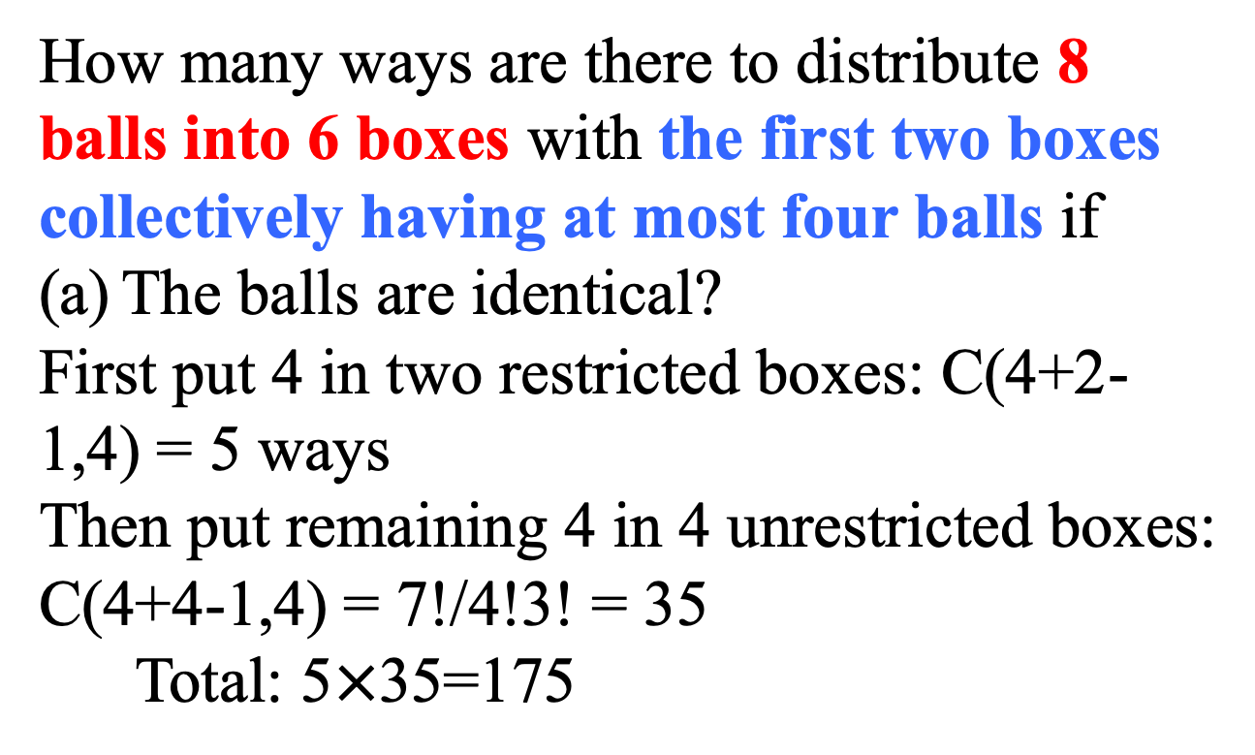
Problem 5.4.28
How many ways are there to distribute 8 balls into 6 boxes with the first two boxes collectively having at most four balls if
The balls are identical?
First put 4 in two restricted boxes: C(4+2-1,4) = 5 ways
Then put remaining 4 in 4 unrestricted boxes:
C(4+4-1,4) = 7!/4!3! = 35
Total: 5$×$35=175

Slide 33
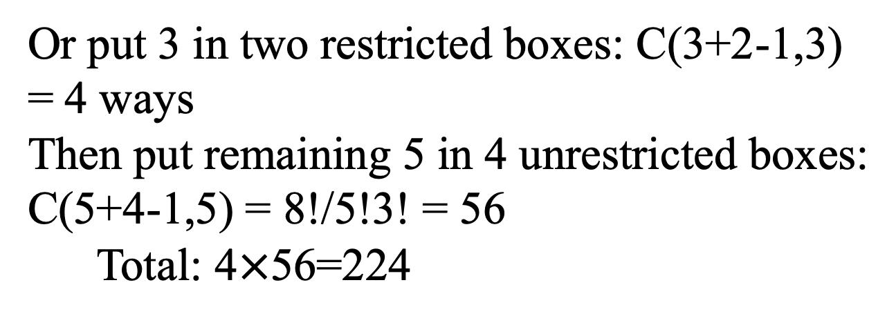
Problem 5.4.28
Or put 3 in two restricted boxes: C(3+2-1,3) = 4 ways
Then put remaining 5 in 4 unrestricted boxes:
C(5+4-1,5) = 8!/5!3! = 56
Total: 4$×$56=224

Slide 34
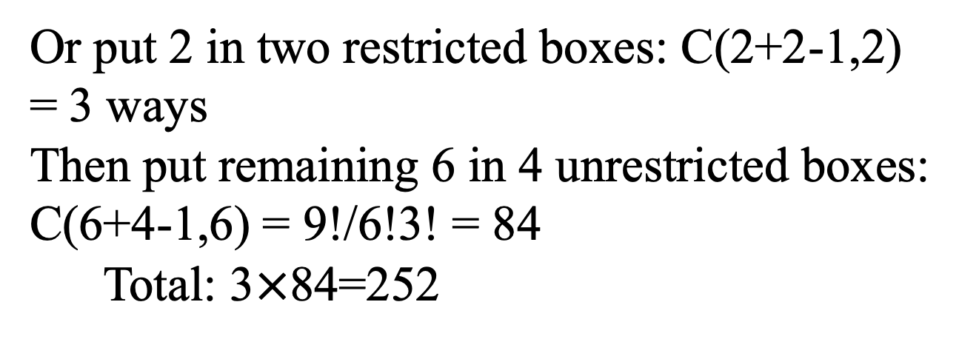
Problem 5.4.28
Or put 2 in two restricted boxes: C(2+2-1,2) = 3 ways
Then put remaining 6 in 4 unrestricted boxes:
C(6+4-1,6) = 9!/6!3! = 84
Total: 3$×$84=252

Slide 35
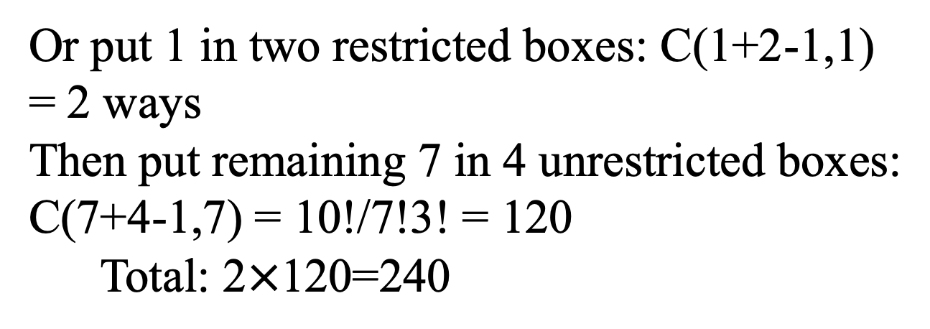
Problem 5.4.28
Or put 1 in two restricted boxes: C(1+2-1,1) = 2 ways
Then put remaining 7 in 4 unrestricted boxes:
C(7+4-1,7) = 10!/7!3! = 120
Total: 2$×$120=240

Slide 36
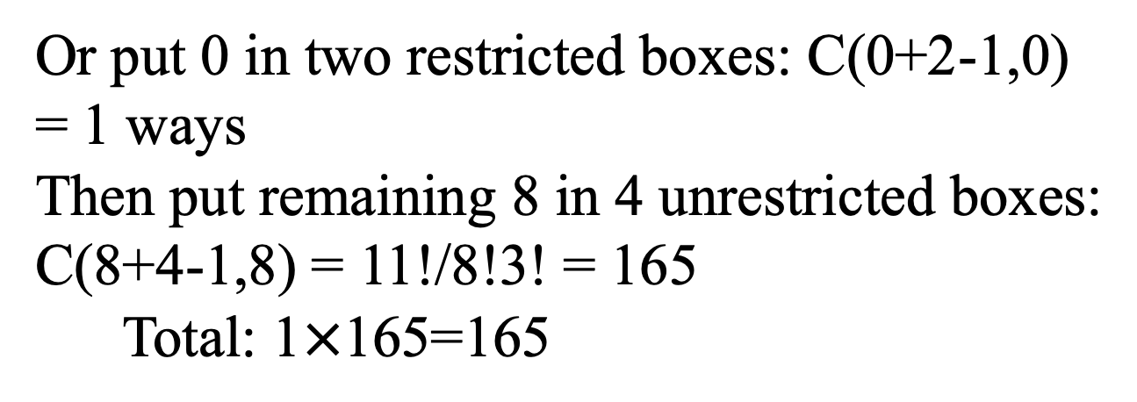
Problem 5.4.28
Or put 0 in two restricted boxes: C(0+2-1,0) = 1 ways
Then put remaining 8 in 4 unrestricted boxes:
C(8+4-1,8) = 11!/8!3! = 165
Total: 1$×$165=165

Slide 37
Problem 5.4.28-cont
Total:
175+224+252+240+165=1050 ways

Slide 38
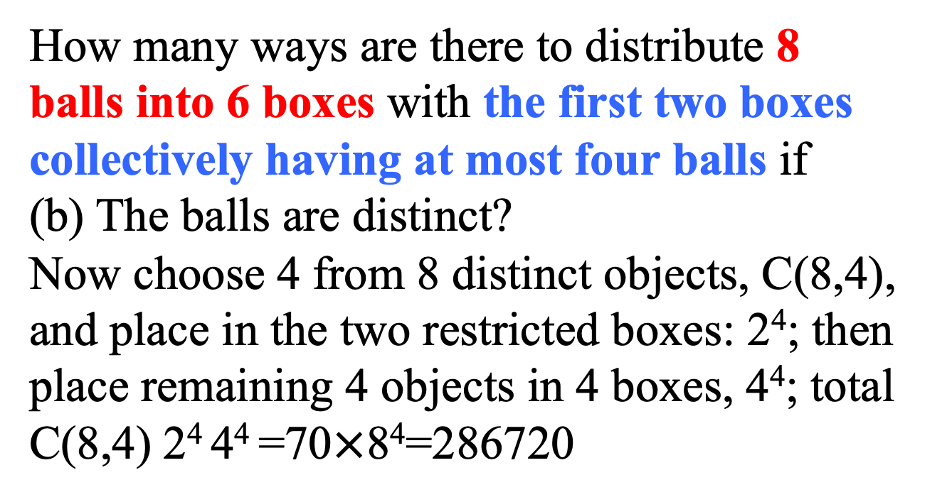
Problem 5.4.28
How many ways are there to distribute 8 balls into 6 boxes with the first two boxes collectively having at most four balls if
(b) The balls are distinct?
Now choose 4 from 8 distinct objects, C(8,4), and place in the two restricted boxes: 2⁴; then place remaining 4 objects in 4 boxes, 4⁴; total C(8,4) 2⁴ 4⁴ =70$×$8⁴=286720

Slide 39
Problem 5.4.28
Or choose 3 from 8 distinct objects, C(8,3), and place in the two restricted boxes: 2³; then place remaining 5 objects in 4 boxes, 4⁵; total C(8,3) 2³ 4⁵=458752

Slide 40
Problem 5.4.28
Or choose 2 from 8 distinct objects, C(8,2), and place in the two restricted boxes: 2²; then place remaining 6 objects in 4 boxes, 4⁶; total C(8,2) 2² 4⁶=458752

Slide 41
Problem 5.4.28
Or choose 1 from 8 distinct objects, C(8,1), and place in the two restricted boxes: 2¹; then place remaining 7 objects in 4 boxes, 4⁷; total C(8,1) 2¹ 4⁷=262144

Slide 42
Problem 5.4.28
Or choose 0 from 8 distinct objects, C(8,0), and place in the two restricted boxes: 2⁰; then place remaining 8 objects in 4 boxes, 4⁸; total C(8,0) 2⁰ 4⁸=65536

Slide 43
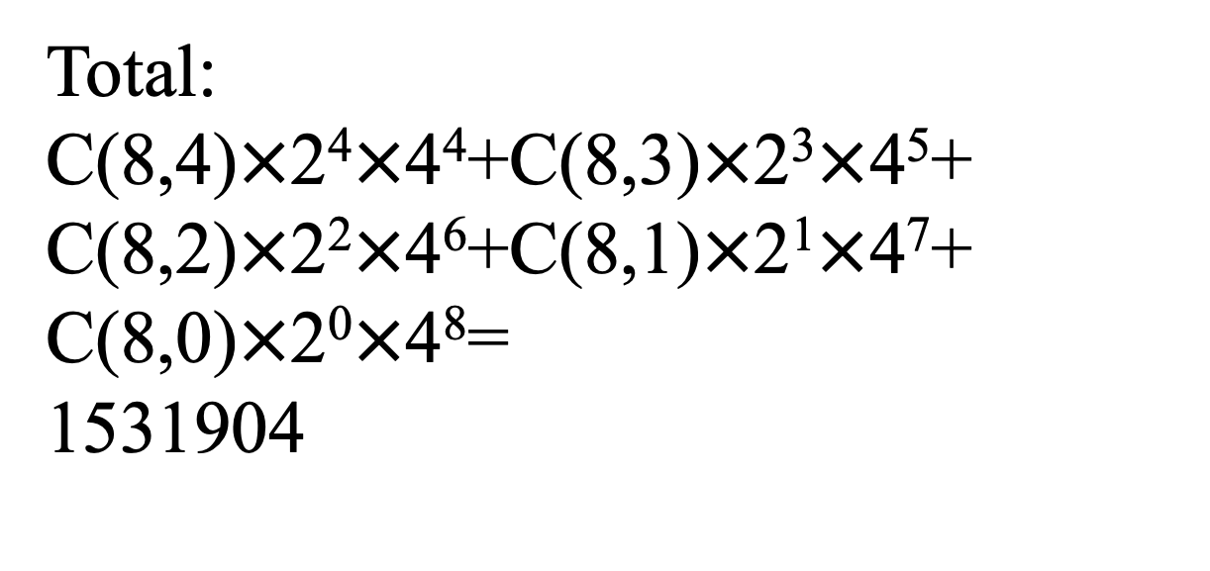
Problem 5.4.28-cont
Total:
C(8,4)$×$2⁴$×$4⁴+C(8,3)$×$2³$×$4⁵+
C(8,2)$×$2²$×$4⁶+C(8,1)$×$2¹$×$4⁷+
C(8,0)$×$2⁰$×$4⁸=
1531904

Slide 44
Problem 5.4.45
How many ways are there to arrange the letters in UNIVERSALLY so that no two vowels occur consecutively and also the consonants appear in alphabetical order?

Slide 45
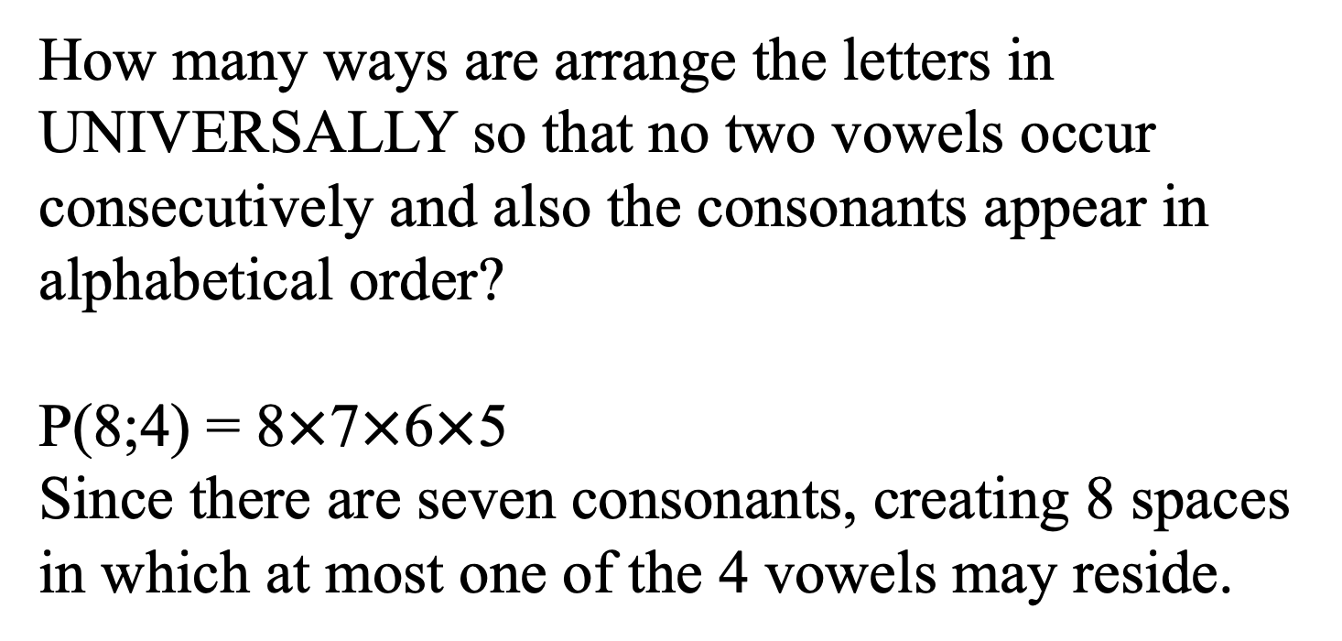
Problem 5.4.45
How many ways are arrange the letters in UNIVERSALLY so that no two vowels occur consecutively and also the consonants appear in alphabetical order?
P(8;4) = 8$×$7$×$6$×$5
Since there are seven consonants, creating 8 spaces in which at most one of the 4 vowels may reside.

Slide 46
Problem 5.4.16
Consider the problem of distributing 10 distinct books among 3 different people with each person getting at least one book.
Explain why the following solution strategy is wrong: first select a book to give to the first person in 10 ways; then select a book to give to the second person in nine ways; then select a book to give to the third person in eight ways; and finally distribute the remaining seven books in 3⁷ ways.

Slide 47
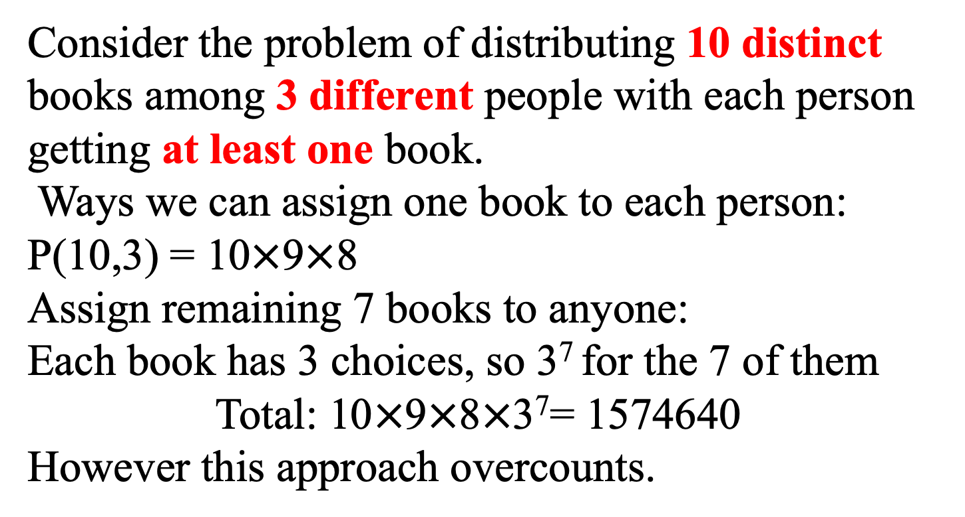
Problem 5.4.16
Consider the problem of distributing 10 distinct books among 3 different people with each person getting at least one book.
Ways we can assign one book to each person: P(10,3) = 10$×$9$×$8
Assign remaining 7 books to anyone:
Each book has 3 choices, so 3⁷ for the 7 of them
Total: 10$×$9$×$8$×$3⁷= 1574640
However this approach overcounts.

Slide 48
Problem 5.4.16 (continue)
The event may follow decomposing into subsequences:
Satisfy it first (give one book to each person)
Distribute the remaining (give 7 remaining books to three people)
However, the two subsequences are NOT independent!
There are overlapings in the counting. Consider Book A to person a. One way person a gets book A could be in the subsequence “satisfy it first”. However if during this subsequence person does not get book A, he/she could also get book A in the subsequence “distribute the remaining books”. So the case of person a getting book A is duplicated.
It is equivalent to say that the counting of “distributing remaining books” is dependent on the first subsequence ”satisfy it first”.

Slide 49
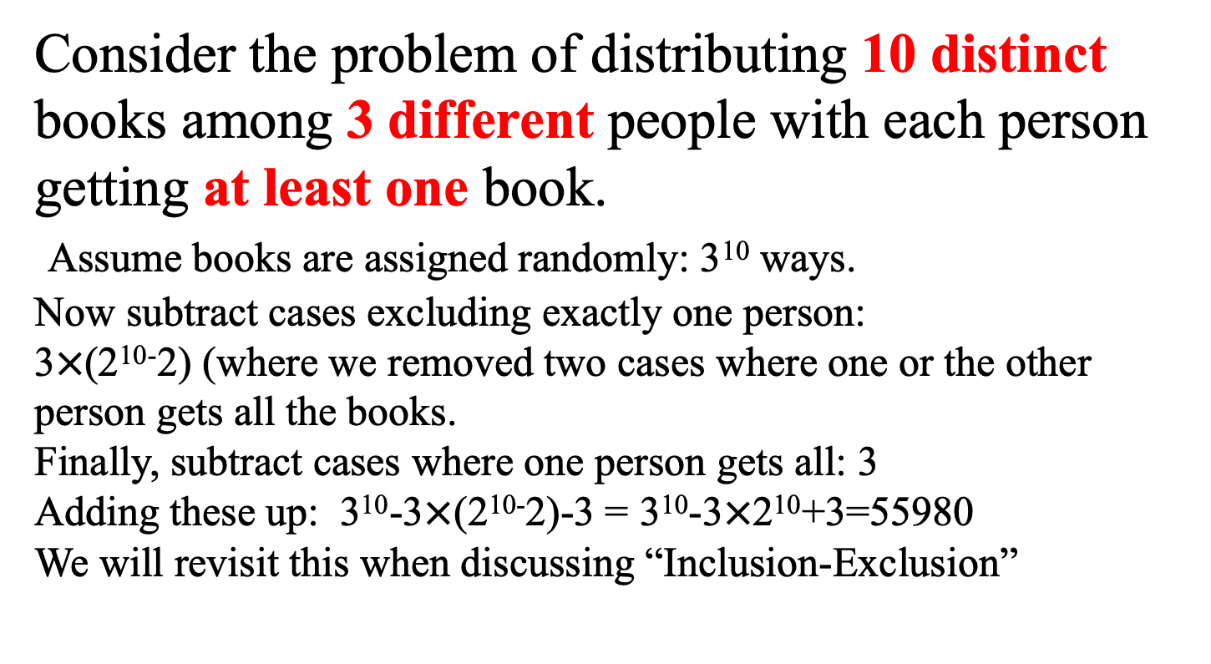
Problem 5.4.16
Consider the problem of distributing 10 distinct books among 3 different people with each person getting at least one book.
Assume books are assigned randomly: 3¹⁰ ways.
Now subtract cases excluding exactly one person:
3$×$(2¹⁰⁻2) (where we removed two cases where one or the other person gets all the books.
Finally, subtract cases where one person gets all: 3
Adding these up: 3¹⁰-3$×$(2¹⁰⁻2)-3 = 3¹⁰-3$×$2¹⁰+3=55980
We will revisit this when discussing “Inclusion-Exclusion”

Slide 50
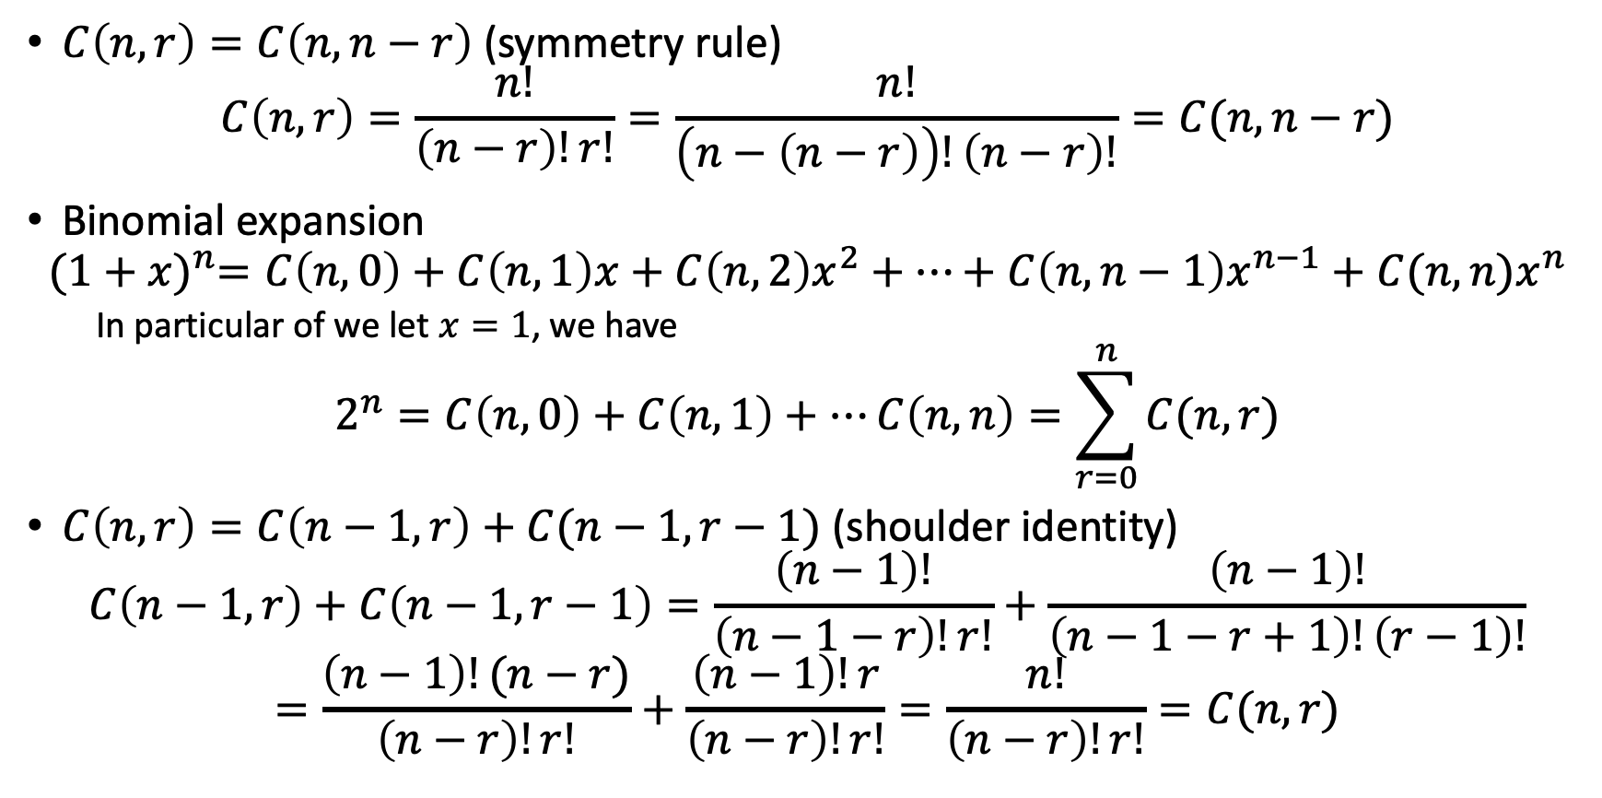
Some combination identities
$C\left(n,r\right)=C\left(n,n−r\right)$ (symmetry rule)
$$C\left(n,r\right)=\frac{n!}{\left(n−r\right)!r!}=\frac{n!}{\left(n−\left(n−r\right)\right)!\left(n−r\right)!}=C(n,n−r)$$
Binomial expansion
$${(1+x)}^{n}=C\left(n,0\right)+C\left(n,1\right)x+C\left(n,2\right)x^{2}+⋯+C\left(n,n−1\right)x^{n−1}+C(n,n)x^{n}$$
In particular of we let $x=1$, we have
$$2^{n}=C\left(n,0\right)+C\left(n,1\right)+⋯C\left(n,n\right)=\sum_{r=0}^{n}{C(n,r)}$$
$C\left(n,r\right)=C\left(n−1,r\right)+C(n−1,r−1)$ (shoulder identity)
$$C\left(n−1,r\right)+C\left(n−1,r−1\right)=\frac{\left(n−1\right)!}{\left(n−1−r\right)!r!}+\frac{\left(n−1\right)!}{\left(n−1−r+1\right)!\left(r−1\right)!}$$
$$=\frac{\left(n−1\right)!(n−r)}{\left(n−r\right)!r!}+\frac{\left(n−1\right)!r}{\left(n−r\right)!r!}=\frac{n!}{\left(n−r\right)!r!}=C(n,r)$$

Slide 51
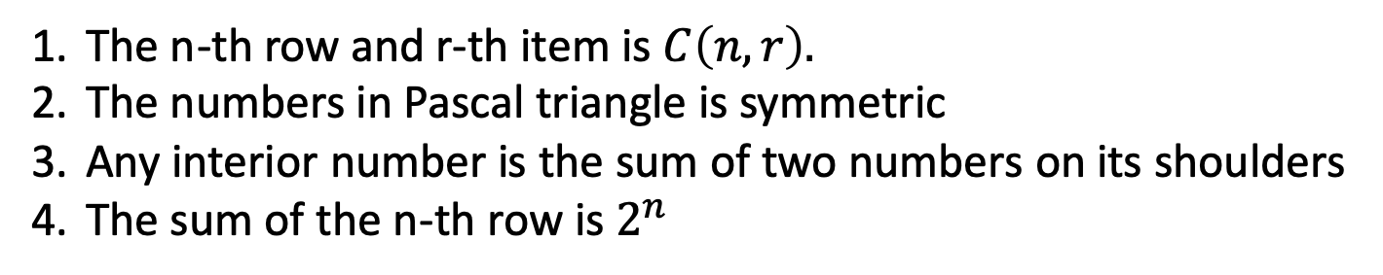
Pascal triangle
The n-th row and r-th item is $C\left(n,r\right).$
The numbers in Pascal triangle is symmetric
Any interior number is the sum of two numbers on its shoulders
The sum of the n-th row is $2^{n}$

